Slide 1


Course: ECO 477
PRESENTED BY
PRESENTED TO
Dr. Nazmul Hoque
Assistant Professor
Department of Economics
East West University
Name | ID
Nafew Prodhan | 2019-1-30-033
Majrima Rahman | 2019-1-30-035
Thaspiaya Jannat Priaya | 2019-1-30-064
Econedge

Slide 2
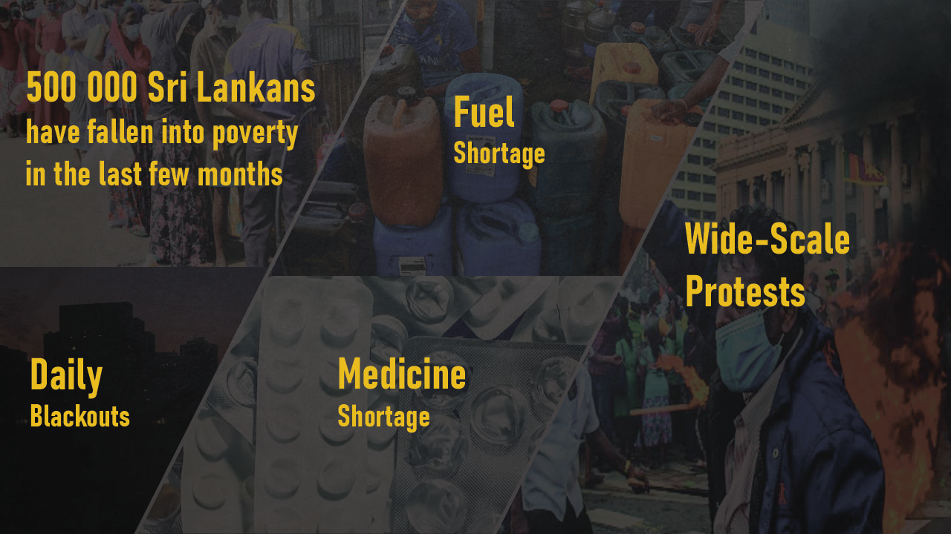

Slide 3
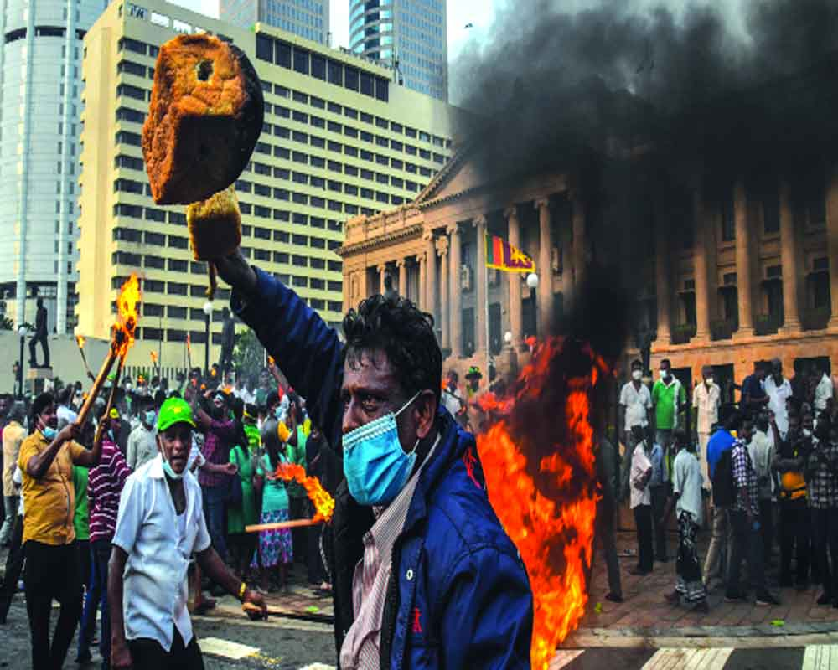


Much more than an Economic crisis
?
How did this happen
Humanitarian crisis

Slide 4




How did this happen
?
Years of Mismanagement
LANKAN ECONOMIC CRISIS
POLICY
POLITICS
DEBT

Slide 5

What’s the lesson
for Bangladesh
Crisis in Sri Lanka

Slide 6
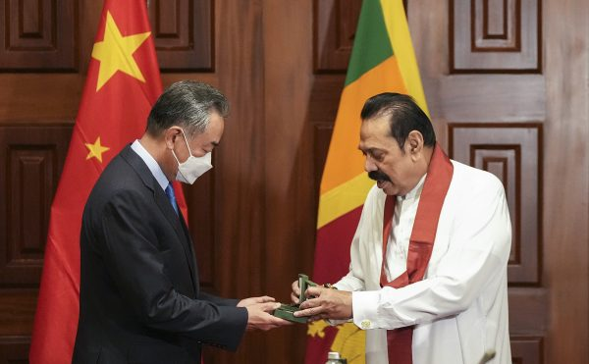
Sri Lanka’s Debt to GDP ratio is 110%
Below than 55% consider as a safer zone
Bangladesh’s Debt to GDP ratio is 38%
Lot less than Sri Lanka
Our foreign per capita debt is $292.11
Sri Lanka’s foreign per capita debt is $1650.
Almost 5 times higher.
Source: Central bank of Sri Lanka, Ministry of Finance - Bangladesh
DEBT

Slide 7
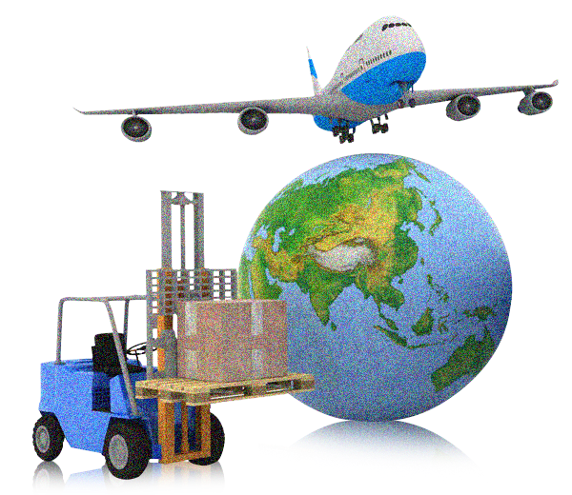




IMPORTS > EXPORTS
DEEP TAX CUTS (Nov 2019)
Downgrading of Sri Lanka’s sovereign ratings
How will country make the money?
DOUBLE DEBT
EXPANDED ITS DEBT
FOREIGN EXCHANGE RESERVE
SPENDING > EARNING

Slide 8

Compared to Sri Lanka, our foreign reserve is much higher than Sri Lanka.
Bangladesh’s Foreign Exchange Reserve is $44146.8 million, Where Sri Lanka’s reserve is only $1723 million
Much more than Sri Lanka
Due to Foreign reserve crisis, Sri Lanka faces:
Fuel reserve crisis. Shortage of food, medicines, cement and other essential items.
Source: Central bank of Sri Lanka, Ministry of Finance - Bangladesh

Slide 9


COVID-19
Foreign reserve crisis in Sri Lanka
Major Source of Foreign Currency
13% of
TOURISM
COVID-19 hit also Remittances
Lankan’s GDP
Source: Central bank of Sri Lanka, Ministry of Finance - Bangladesh

Slide 10
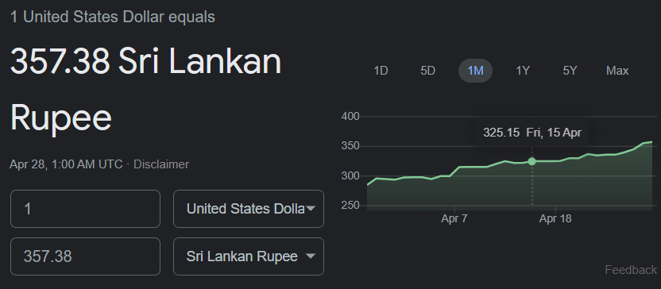

Foreign reserve crisis in Sri Lanka
Source: Google. Apr 28, 2022
To encourage remittances and
qualify for a loan from the IMF
Gotabaya Rajapaksa devalued
the Sri Lankan rupee
Effect Domestic Market Prices
Import became Expensive
Currency has plunged 32%

Slide 11


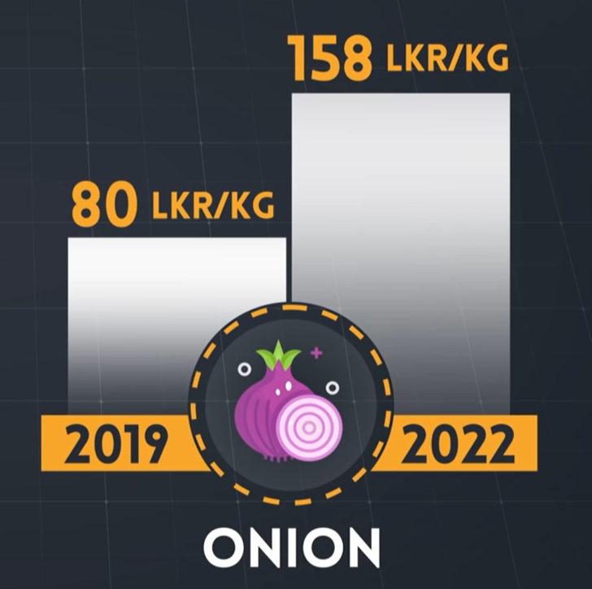
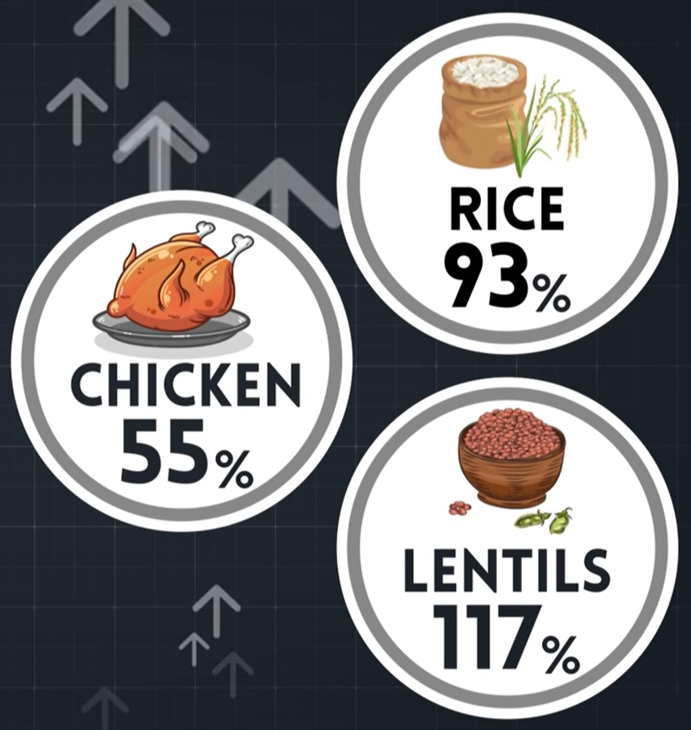
INFLATION 30.2%

Slide 12
IMPORT RESTRICTION
Chemical Fertilizers banned in Sri Lanka
Shortage of food
Sri Lanka forced to import rice
Bans on import of luxury goods
SHORT TERM RELIEF
Continuing ban on imports would affect the exports too because export industry of Sri Lanka is largely dependent on import of intermediate capital goods.
SAVING FOREING RESERVES: SCRAMBLING FOR DOLLARS

Slide 13
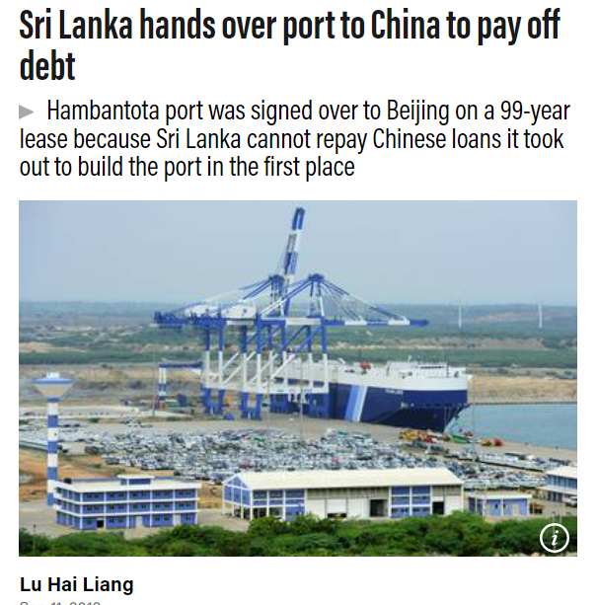

Assistance from Bilateral Partners
Chinese debt trap diplomacy
Figure: Share of debt stock by major lenders
No to International Monetary Fund (IMF) Bailout
Source: Central bank of Sri Lanka, Al Jazeera

Slide 14
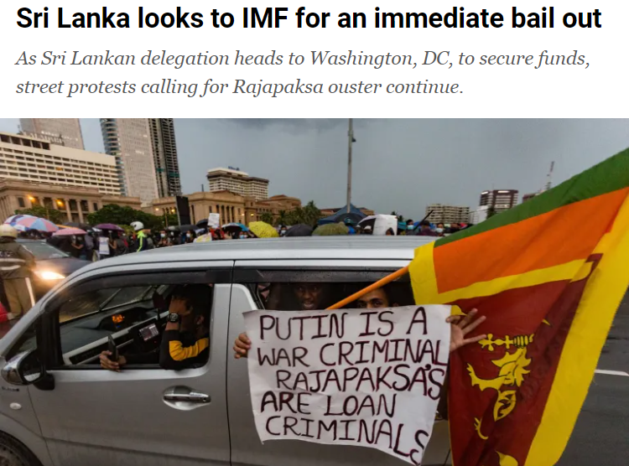
But now,
Debt
Restructure
IMF
Relief package
Public debt = 110% of GDP
Source: Al Jazeera. Apr 15, 2022
Risk of Defaulting

Slide 15



Why they said no to IMF?
IMF
"IMF will give directions for changing your economic policies"
MONEY COMES WITH STRINGS ATTACHED

Slide 16
Lessons for Bangladesh
Though Bangladesh's economy is apparently doing well
Diversification is a necessity, not an option.
Avoid the temptation of undertaking large projects unless those are economically viable
Sequence borrowing in a way that does not pile up repayment pressure.
Loans should be used in a way that increases domestic productive capacity with respect to export diversification, skill development and enhancing private investment.
Debt payment – As we are becoming an upper-middle income country

Slide 17
THANK YOU

